Slide 1
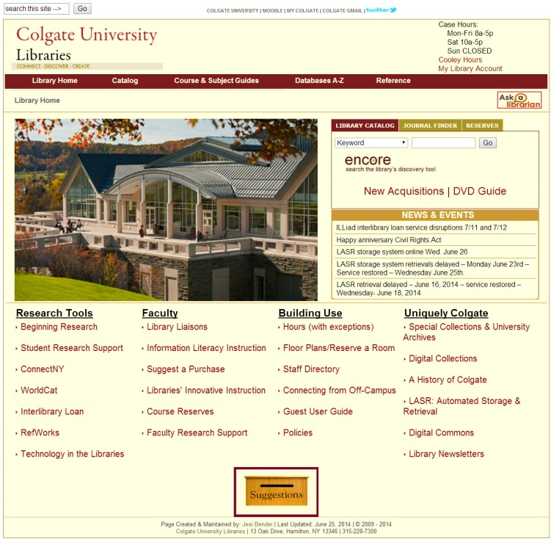
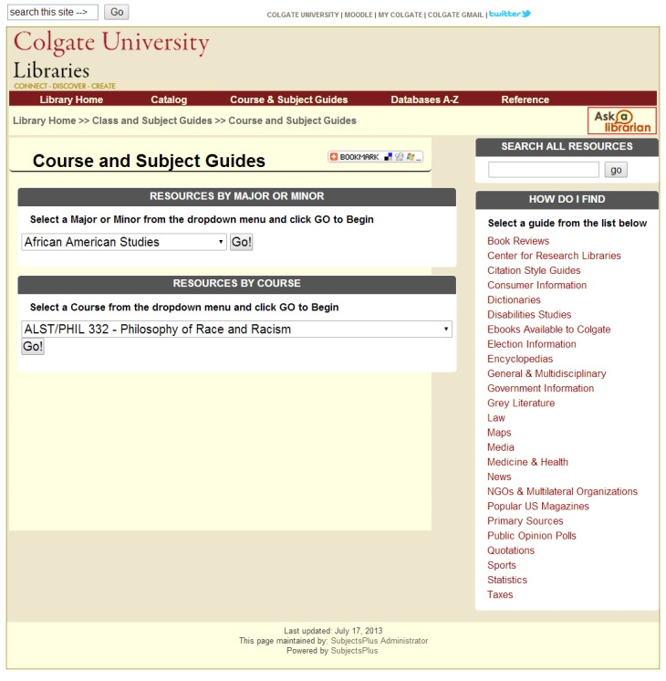
Draft Research Data Services Sitemap
Please write on me!
What do you think of
the proposed site
elements and their
organization?
Library Home Page
(level 1)
Please write on me!
What do you think of
the proposed site
elements and their
organization?
Major Guides
include data material as needed
Course and Subject
Guide Page (level 2)
Course Guides
include data material as needed,
also any page(s) can be linked to Moodle
Maps and Geospatial Data
Home Page
includes Best Sources
and Map Citation information
Research Data Services
Home Page
includes Best Sources, Data Citation,
and Data Life Cycle information
Statistics
Quick numbers for
those who don’t need
large data sets
Government
Information
Public Opinion
Polls
Maps
Data Sources
Geospatial Data
US
International
General
Historical Maps
Virtual Data Support Lab
video tutorials and FAQ for software
and data source identification
Historical
Agriculture & Food
Interactive Mapping
Sites
Teaching with Data
Colgate-Specific
Includes material from
Mellon projects
Children
Environment
& Climate
Crime
Shale Gas Maps
and Countermaps
Data Analysis Tools
Demographic
Health
Level 3
Data Visualization Tools
Economic
Sports
Level 4
Education
Data Management
and Archiving Tools
Women
Energy
Level 5

