Slide 1
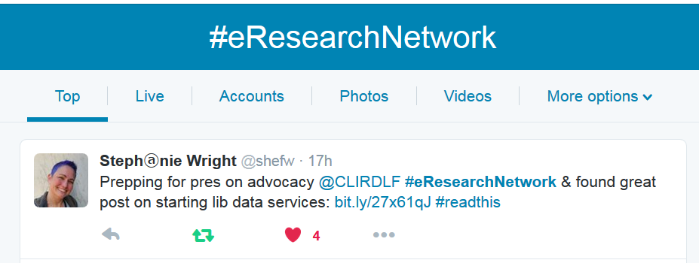
twitter as channel (#hashtag)
@jaclark #DLFforum

Slide 2
Stephanie Wright
Steph is a former University of Washington data librarian and now an open science advocate at the Mozilla Science Lab where she leads the development of their open data training program. She works with researchers, students, non-profit organizations, librarians and citizen scientists to help them learn, teach and advocate for open science.
Prior to delving into data services, Stephanie worked as a science librarian, an assessment librarian and as a computing trainer on a cruise ship and for the Bill & Melinda Gates Foundation.

Slide 3
Overview
Speaker
Q and A
Discussion of Assignment
Open Forum

Slide 4
Session 1 Assignment
Data Management Roadshow
Data Management Curriculum

Slide 5
Questions?
twitter.com/jaclark
jaclark@montana.edu
twitter.com/saramannheimer
Sara.Mannheimer@montana.edu

Slide 6
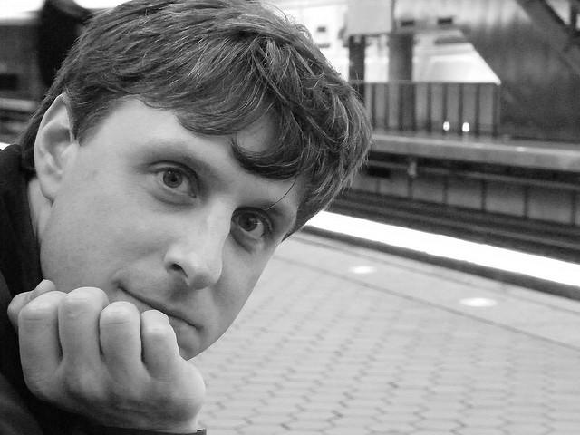

Slide 7
Data Advocacy
Creating a Community of Champions
DLF eResearch Network
18 May 2016
Stephanie Wright
Open Data Training Lead
Notes:
Resources at end of slide deck.
These materials will be made available.

Slide 8
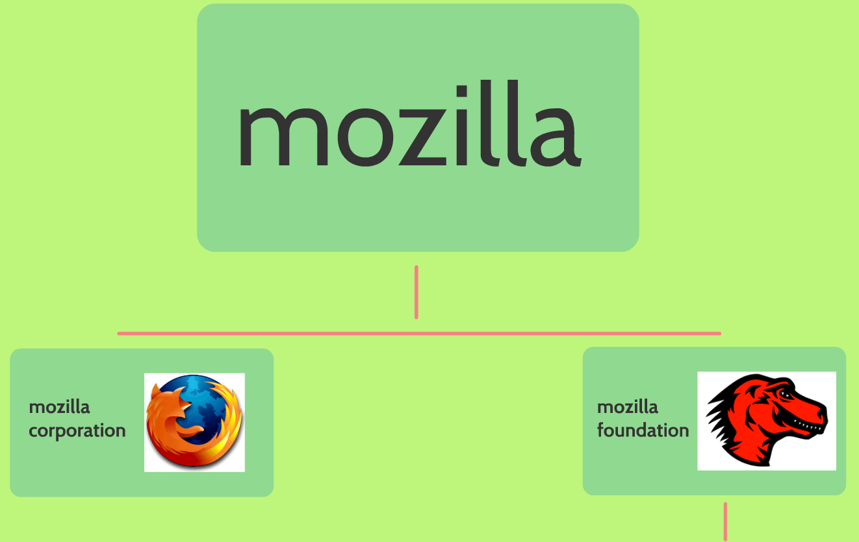
What is…
Notes:
What is Mozilla?
Corporation side - Firefox;
Foundation side - owns the corporation and is comprised of paid employees and volunteers pursuing a mission to ensure the Internet is a global public resource, open and accessible to all.
What do I do for them?
I work on the Mozilla Science Lab Team as Open Data Training Lead - leading development of curriculum around open data; training for practitioners as well as developing training for trainers in this area.
How I got here
Former Atmospheric Science Librarian, Assessment Librarian, and Data Services Coordinator at UW. All of those have contributed to where I am right now.
Five years ago I was in the first cohort of the ARL eScience Institute w/ two of my associate deans
Our success at UW and at Mozilla is built on community building
Research Data Services is not a one-person show

Slide 9
It’s All about who you know
“…when people have an information need, they’ll always ask people they know before they ask a librarian.
The trick is making sure that librarians are some of the people they know.” —Jessamyn West
Notes:
I was the first.
Library committee to determine need for research data services support
Environmental scan
Who’s doing stuff already?
Wasn’t sure EXACTLY what our constituents wanted / needed
Jessamyn West quote
“…when people have an information need, they’ll always ask people they know before they ask a librarian. The trick is making sure that librarians are some of the people they know.”
They weren’t going to come to me, so I had to go to them

Slide 10
They may be too busy for a meeting
Coffee Heart Art from publicdomainpictures.net
Notes:
Started out w/ a lot of coffee conversations
Meetings vs coffee – too busy for a mtg but will spend an hour over coffee
Casual, non-threatening
Identify gaps, not take over what they were doing
Each mtg ask “who else should I be talking to?”

Slide 11
Reaching out the First year
Institute for Health Metrics & Evaluation
Center for Advanced Research Technology in the Arts & Humanities
Center for the Study of Demography & Ecology
Center for Social Science Computational Research
Office of Research
eScience Institute
Notes:
Initially folks / groups identified in environmental scan: think broadly
These are the names for our research groups & offices, yours may be similar… or very different
IHME
CARTAH
CSDE
CSSCR
Ofc of Research
eSci Institute *
Background of assessment so started with a survey & interviews
These conversations helped frame survey questions

Slide 12
Survey says…
PIs & Co-PIs from across the campuses
Grant proposals from 2010-2012
Survey population < 3200
323 valid responses
Over 100 possible interviews
Notes:
Contacted Office of Sponsored Programs and asked for list of PIs & co-PIs across all three campuses for grant proposals granted between 2010 and 2012
Kept it short, only 14 questions
Last question: Are you willing to participate in an interview
323 responses to survey, of those over 100 agreed to be interviewed
These became our targets / our champions
We only interviewed 16 from the different broad disciplinary categories
From there, used full list of over 100 willing interviewees as list of champions
More coffee
Got invited to dept mtgs
New working groups & grant projects with a focus on data
Asked to participate in events
Those relationships exist today

Slide 13
tips
Look at what’s already out there: http://www.citeulike.org/group/18394
Plan for the time it will take. Give yourself (and tell someone else) a deadline.
Keep it short.
Don’t ask a question when you can get the information another way.
Only ask questions that give you actionable intel.
SHARE WHAT YOU LEARNED and how you acted on the feedback.
Notes:
A few tips:
Before you go out and do your own, I recommend looking at what’s already out there. Survey fatigue
Surveys are a lot of work, especially to be done correctly
Plan for how much time it will take to actually write up results
Put it in your calendar! Give yourself a due date and tell someone to whom you are accountable what that date will be.
Don’t waste your participants time
Keep it short
Don’t ask questions for something where you can get the answers another way
Only ask questions that give you actionable intel
Keep in mind the purpose of your survey and how each question addresses that goal
SHARE what you learned and how you acted on the feedback

Slide 14
OUTREACH
Conferences
Working Groups
Workshops
Publications
Webinars
Regional Org
Notes:
External to my institution was easier:
Conference presentations
Working groups
Workshops
publications
Even created our own regional group of data librarians, meet annually to share
Great uptake/attendance/interest
Throw your imposter syndrome out the window
People want to know about your experiences
Join orgs / lists
See Webliography (resource 3) on Resources slide, particularly Data Orgs

Slide 15
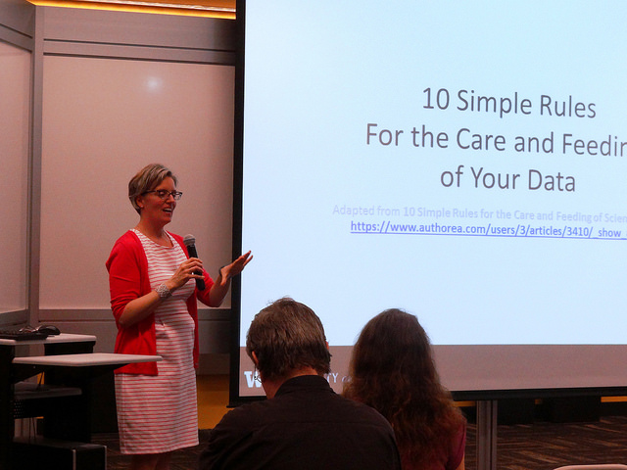
INREACH
INFORMAL
Brown bags
Data Cafes
FORMAL
Data Services forums
Workshops
Invited speakers
Notes:
Informal
Brown bags
Data Cafes
Formal
Data Services forums
Workshops
Invited speakers
Best attendance happened when our associate dean sent out a message encouraging attendance
Support from administration is crucial
Lends authority to the “this is important” part of your message
We tried different messages about data management:
Don’t worry… ask us!
It’s just like other forms of information with which you’re familiar
If I had it to do over: build the relationships first, just like w/ researchers

Slide 16
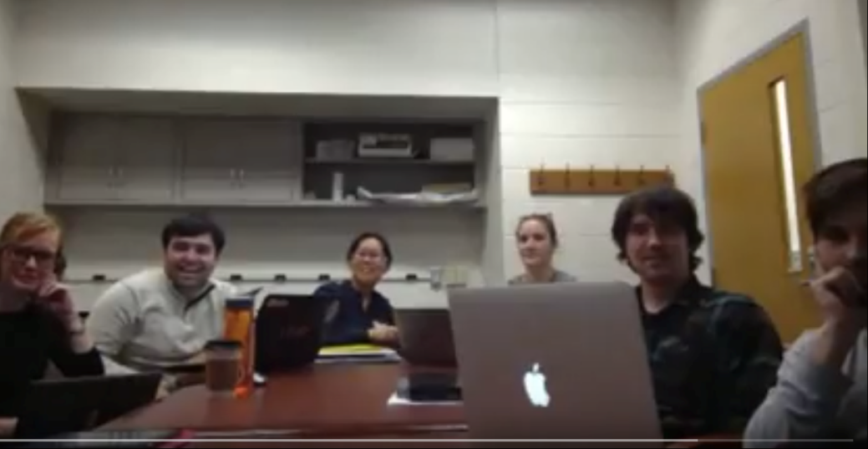
LIKE MOZILLA
Notes:
Focus is on open data, open science, working open
Eat our own fox food: Work in the open on GitHub, Google Docs, and public etherpad
So much easier to collaborate when you can see what everyone’s been doing
Global organization & distributed team means building & maintaining rel’ships virtually & f2f
Expanded on building community
We are an organization with a large network of volunteers, people who believe passionately in what we’re doing
Tweets
Virtual meetings / teachings

Slide 17
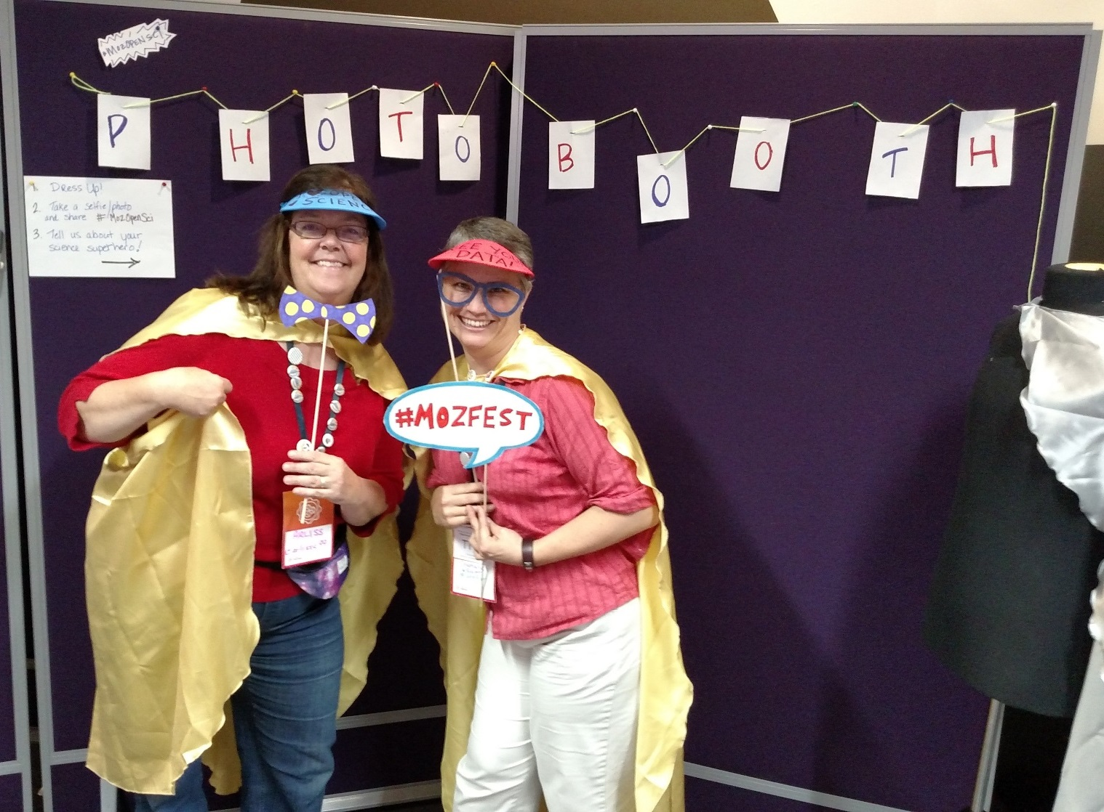
LIKE MOZILLA
Notes:
Really broadened my view of collaboration
MozFest, kids and developers working on MineCraft
Broadened outside academia and researchers to include:
Gov
NGO
Citizen sci
Required thinking about language we use; less jargon
More explicitly address WHY this is important
Make it as easy as possible
Make it fun and interesting
Bring in lots of real life examples: Primer 1

Slide 18
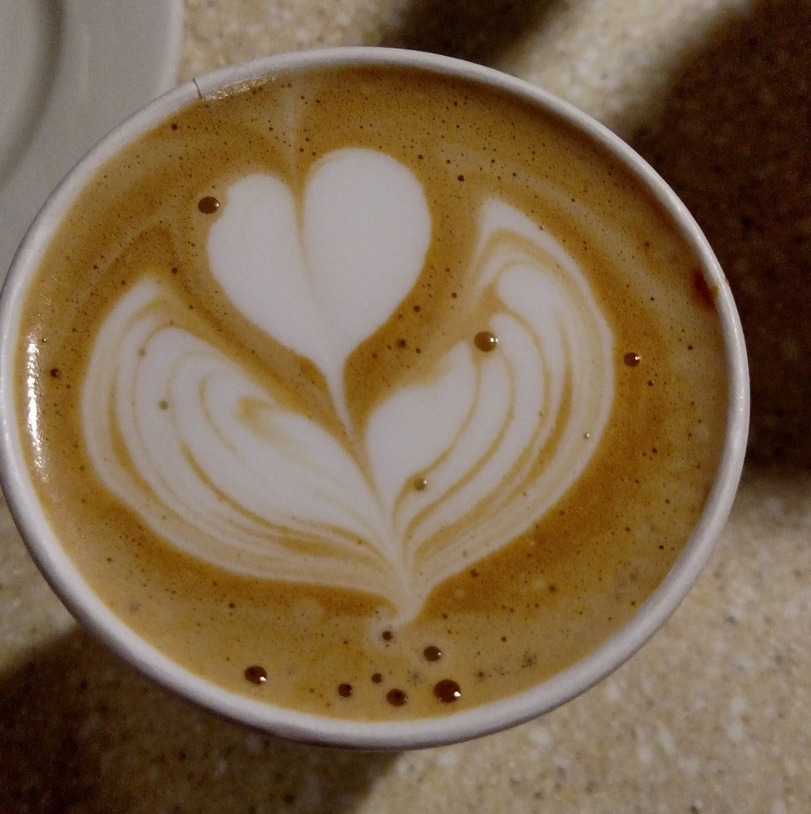
LIKE MOZILLA
Notes:
Coffee like Mozilla

Slide 19
Key points
Identify needs
Build relationships with a personal touch
Look for every opportunity to expand your network
Be prepared with “an ask”
Connect your champions with each other
Don’t try to do it all at once

Slide 20
Collaborate with US
Stephanie Wright
stephanie@mozillafoundation.org
Twitter: @shefw
GitHub: @stephwright
Mozilla Science Lab: mozillascience.org

Slide 21
RESOURCES
Embracing library-supported research data management services http://www.briannamarshall.com/2016/05/02/library-rdm/
Bibliography of RDM needs assessments http://www.citeulike.org/group/18394
Research Data Management Self-Education for Librarians: A Webliography http://istl.org/15-fall/internet2.html
Jargon Busting Exercise http://bit.ly/dejargon
Challenges to Open Data & How to Respond http://bit.ly/ODChallenges
Friendly Introduction to GitHub http://joeyklee.github.io/friendly-github-intro/

