Slide 1
Maps, Space, and Environmental Justice
Peter Rogers
ENST 232
10/29/13

Slide 2
Neo-geography
Key technologies
Political and social implications
Two examples
Krygier and Wood
EJView
Syracuse questions
Writing assignment 2

Slide 3
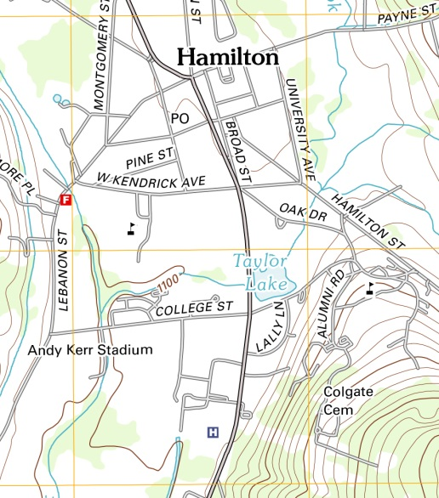
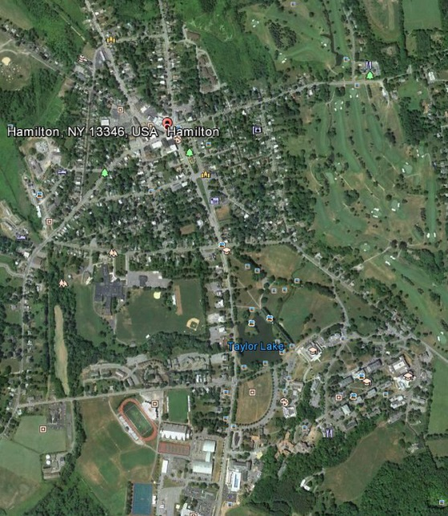
Neo-geography
Past
People consumer
Experts produce
Present
Everyone consumes and produces

Slide 4
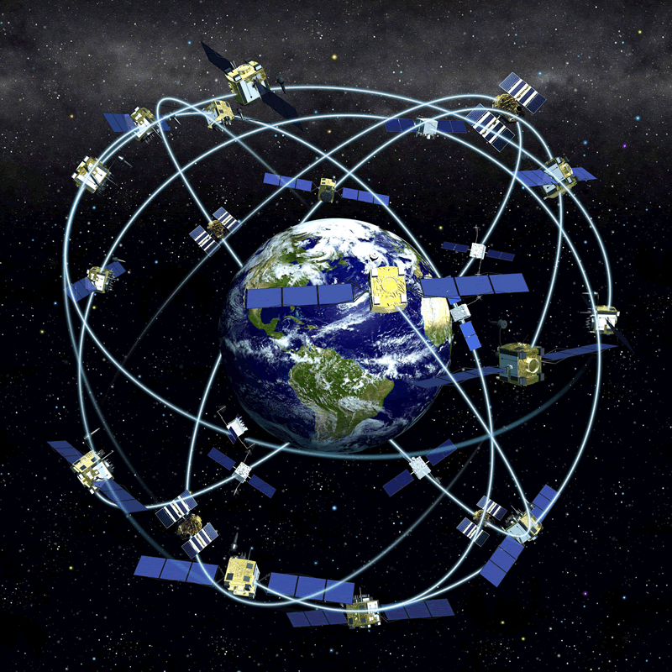
Key Technologies
Gather geospatial data
Manipulate and analyze geospatial data
Distribute geospatial data

Slide 5
Political and Social Implications
Maps as political statements
Historically enhanced state power
Now cycle of maps, counter-maps, counter-counter-maps, . . .

Slide 6
Two Examples
Google Earth
Global Awareness layer
Google Earth Outreach
Shale Gas Maps and Counter-Maps

Slide 7
Krygier and Wood
What’s a map?
What, if anything, makes maps different from other methods of communicating information?
Krygier and Wood argue that maps are _____?
How do they support their argument, and do you agree with them?
What do they see as the chief implication of their argument for map-makers?
What did you think of this style of scholarly communication?

Slide 8
EJview
Data from
EPA
USGS
Census
Elements
Search
Zoom, pan, and drag
Basemap
Layers
Cursor tools
Help topics
Print
Screen capture
Image editing software (GIMP and Photoshop)

Slide 9
Playing with EJview in Syracuse
Can you find the Midland Avenue Regional Treatment Facility? Who lives near it?
Can you find the Superfund report for Onondaga Lake?
Does there appear to be a pattern racial/ethnic segregation in housing in Syracuse?
What economic variables appear to be related to racial/ethnic distributions?
What are some of the environmental and demographic characteristics of the Southwest and Brighton neighborhoods

Slide 10
Writing Assignment 2
Part I
1. Select EJview topic
2. Select geographic area
3. Determine environmental injustice variables
Part II
1. Develop 2-4 maps
2. Clear resolution and understanding
3. Labels and legends
Part III – 4-5 page paper
1. Explain injustice with appropriate literature
2. Explain how the map illustrates the injustice
3. Based on other cases, consider how this case could have come about
4. Critique the maps that you created
What did you choose not to include?

